Slide 1
VE-State Review Meeting
December 18, 2018
Review
Completed Models and Modules
Modules and Testing to be Completed
Issues
VE-State Inputs

Slide 2
Series of Meetings
Oversight Group Expectations:
Influence direction of work
Understand approach to work
“Concept” level background
VE-State pilot project
Consultant team:
Oregon Systems Analytics & RSG
Oversight Group: FHWA, Volpe, MdDOT-BWI, WSDOT, ODOT
Oversight Group charge: Review the plan/methods with the objective to further this pilot’s findings/products as part of future pooled fund activities, and participate in necessary changes to the VE framework.
Note: Funding/schedule limit the oversight role to one of primarily review and advice.
Schedule: June-November 2018, roughly 4-5 monthly 1.5 hour meetings
May 30, 2018 – Kickoff
July 5, 2018 – Input on “Integration Plan” approach
Oct 3, 2018 – Review approach, 3D code/inputs, remaining code plans
Dec 18, 2018 – Review full code/inputs, Oregon “real world” Test, Final Report
Other: E-forum (between meetings); Wiki Status Report, GitHub Issue Tracking
Product: “Integration Plan”; code & inputs; Documentation of Issues for future efforts
Notes:
VEState Kickoff Meeting (5/30 11 to 12:30)
Introduction (Tara – 20 min)
Purpose of Project & Oversight Group role
(understand approach, VE context/background, how influence direction, concept level, mtgs/process)
Why VisionEval? Why this project now?
(plug-play modular benefits, VE RSPM milestone, VE pooled fund)
Roundtable introductions, including interest, VE tools experience, GreenSTEP/EERPAT comments/challenges, etc.
Draft Work Plan (Brian – 60 min)
Differences between GreenSTEP/EERPAT and RSPM –15 min
Moving from VE-RSPM to VE-State – 30 min
Project Work plan – scope, schedule – 15 min
(include planned data sources; end with links to github & doc--GreenSTEP?VE-RSPM?)
Next steps (Tara – 10 min)
How we plan to engage you?
E-discussion forum (VE wiki?)
List of Qs for post-meeting response
“Integration Plan” pre-meeting; to be discussed at meeting #2 for input prior to implementation
Mtg #1 Qs:
In your experience with GreenSTEP/EERPAT
Were there any concerns with the inputs, especially related to synthetic household set-up and customization for local areas
What data do you have to provide input on ???
Any other challenges or concerns that sufaced in your analysis that we should try to address in VE-State version?
VEState 2nd Meeting (7/5 9:30 to 11)
Intro (Tara – 5 min)
Integration Plan” presentation/discussion of approach (Brian – 30 min)
Discussion, adjustments to the approach (Brian/Tara – 45 min)
Next steps; Qs for post-meeting response, e-forum (Tara – 10 min)
Mtg #2 Qs:
1. Do you have any concerns about the proposed inputs (new or old) as noted in the proposed approach, especially related to synthetic household set-up and customization for local areas
2. Do you have any comments, concerns, or ideas on the proposed approach for synthesizing household attributes
VEState 3rd Meeting (Early Oct 2-4 TBD)
Intro (Tara – 5 min)
Report out on completed efforts, before final test on Oregon data (Brian – 20 min)
Report on remaining task (Brian/Tara -- 30 min)
Documentation of issues for future efforts (20 min)
Next steps; Qs for post-meeting response, e-forum (Tara – 10 min)
Mtg #3 Qs:
1. Do you have any comments, concerns, or ideas on the work to date that should be reflected in issues for future efforts?
VEState 4th Meeting (Early Dec 4-6? TBD)
Intro (Tara – 5 min)
Reporting results (Brian – 45)
Documentation of issues for future efforts (20 min)
Next steps; VE Pooled Fund pick up outstanding issue, add EERPAT functionality (Tara – 10 min)
Mtg #4 Qs:
1. Do you have any comments, concerns, or ideas on the work completed under this project that should be reflected in issues for future efforts?

Slide 3
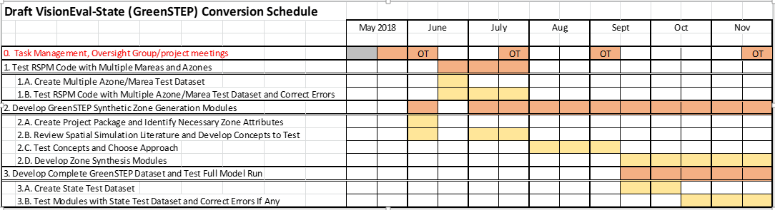
Work Program
3
May
June
July
Aug
Sept
Oct
Nov
16
Notes:
3

Slide 4
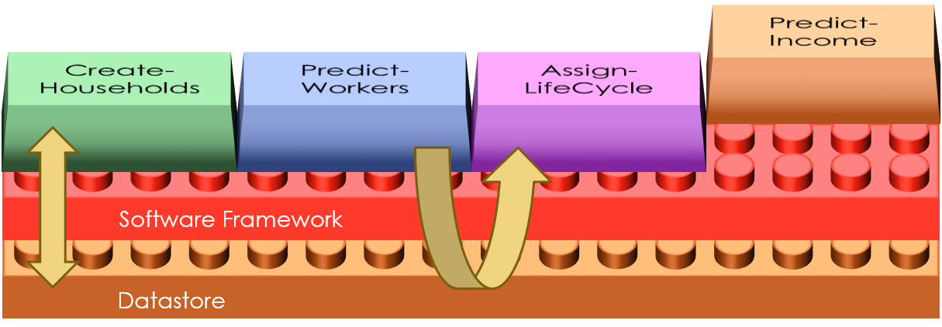
Review VisionEval Model System Architecture
Modules
Framework
Datastore
library(visioneval)
InitializeModel()
runModule(“CreateHousehold”)
runModule(“PredictWorkers”)
runModule(“AssignLifeCycle”)
runModule(“PredictIncome”)
...
VE Architecture Facilitates
Modularization
Customization
Open Science Approach
  Replicable model estimation
  Documented data flow and procedures
  Collaborative development
Model Script
Notes:
4

Slide 5
Review Model Geography
5
Standardized so that modules can be shared.
Flexible so that models can operate at different scales.
Region: Study area (e.g. state, metropolitan area)
Azones: Community (e.g. county, PUMA, city)
Population synthesized at this level
Bzones: Neighborhood (block group)
Czones: Development (Not implemented yet)
Mareas: Urbanized area association
Notes:
5

Slide 6
Bzones may be real or synthesized.
VE-RSPM: Real
VE-State: Synthesized
B1.1
B2.1
B2.2
B2.1
B2.2
B1.1
B2.3
B2.4
B2.3
B2.4
B1.2
B1.2
B3.1
B5.1
B3.1
B5.2
B1.3
B3.2
B1.3
B3.2
B4.1
B5.2
B5.3
B4.1
B5.1
B5.3
Region
Azones
Bzones
Notes:
6

Slide 7
VE-RSPM Modules and Packages
7
CreateHouseholds
PredictWorkers
AssignLifeCycle
PredictIncome
SimHouseholds
Package
CalculateHouseholdDvmt
CalculateAltModeTrips
CalculateVehicleTrips
DivertSovTravel
HouseholdTravel
Package
PredictHousing
LocateEmployment
AssignLocTypes
Calculate4DMeasures
CalculateUrbanMixMeasure
AssignParkingRestrictions
AssignDemandManagement
AssignCarSvcAvailability
LandUse
Package
CalculateCarbonIntensity
AssignHhVehiclePowertrain
PowertrainsAndFuels
Package
TravelPerformance
Package
Iterate X Times
CalculateBaseRoadDvmt
CalculateFutureRoadDvmt
CalculateRoadPerformance
CalculateMpgMpkwhAdjustments
AdjustHhVehicleMpgMpkwh
CalculateVehicleOperatingCost
BudgetHouseholdDvmt
End Iteration
CalculateComEnergyAndEmissions
CalculatePtranEnergyAndEmissions
AssignTransitService
AssignRoadMiles
TransportSupply
Package
AssignDrivers
AssignVehicleOwnership
AssignVehicleType
AssignVehicleTable
AssignVehicleAge
CalculateVehicleOwnCost
AdjustVehicleOwnership
HouseholdVehicles
Package
Notes:
7

Slide 8
VE-State can be created from VE-RSPM with a few focused changes
8
CreateHouseholds
PredictWorkers
AssignLifeCycle
PredictIncome
SimHouseholds
Package
CalculateHouseholdDvmt
CalculateAltModeTrips
CalculateVehicleTrips
DivertSovTravel
HouseholdTravel
Package
CreateSimBzones
PredictHousing
LocateEmployment
Calculate4DMeasures
CalculateUrbanMixMeasure
AssignParkingRestrictions
AssignDemandManagement
AssignCarSvcAvailability
SimLandUse
Package
CalculateCarbonIntensity
AssignHhVehiclePowertrain
PowertrainsAndFuels
Package
TravelPerformance
Package
Iterate X Times
CalculateBaseRoadDvmt
CalculateFutureRoadDvmt
CalculateRoadPerformance
CalculateMpgMpkwhAdjustments
AdjustHhVehicleMpgMpkwh
CalculateVehicleOperatingCost
BudgetHouseholdDvmt
BalanceRoadCostsAndTaxes
End Iteration
CalculateComEnergyAndEmissions
CalculatePtranEnergyAndEmissions
AssignTransitService *
AssignRoadMiles
TransportSupply
Package
AssignDrivers
AssignVehicleOwnership
AssignVehicleType
AssignVehicleTable
AssignVehicleAge
CalculateVehicleOwnCost
AdjustVehicleOwnership
HouseholdVehicles
Package
* Modify to synthesize distance to transit measure (D4c)
Notes:
8

Slide 9
Test and modify modules developed for VE-RSPM to assure that they work for VE-State
9
Test VE-RSPM with a multi-Azone, multi-Marea dataset
  Made corrections to modules as necessary
  Testing successful
Modified VE-RSPM modules to replace DevType (Urban, Rural) with LocType (Urban, Town, Rural) to be consistent with VE-State place type taxonomy
    Location Type, Area Type, Development Type
  Modified respective VE-RSPM test input files and tested successfully
Notes:
9

Slide 10
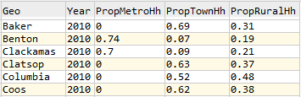
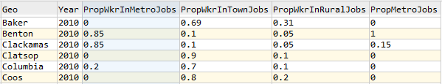
Creating SimBzones
10
Similar inputs to GreenSTEP & EERPAT
  Proportional allocation of Azone activity to location types
  Activity density by Azone location type determines distribution of neighborhood density
Differences
  Activity is jobs and households, not just population
  Considers allocation of jobs among Azone portions of urbanized area
azone_hh_loc_type_prop.csv
Note: an Azone may be associated with an Marea, but not have urbanized area in the Azone. This improves modeling of commuters.
azone_wkr_loc_type_prop.csv
Notes:
10

Slide 11
Creating SimBzones (cont.)
11
GreenSTEP & EERPAT have simple generic model to predict distribution of census tract population density
CreateSimBzone module uses detailed EPA Smart Location Database:
  Predict household and jobs density distribution at census block group level
  Uses detailed profiles of characteristics of hundreds of urbanized areas as well as more generic size-based area profiles to enable SimBzones to better reflect actual conditions
SimBzones are created with more attributes to support future deployment of multi-modal travel model
  5Ds: density, diversity, design, destination access., distance to transit
Defines place types to enable more discrimination as to how policies (parking, TDM, car service) policies are applied
  Area Type: center, inner, outer, fringe
  Development Type: residential, mixed, employment
Notes:
11

Slide 12
Status - completed
12
All modules in VESimHouseholds package tested with Oregon test datasets
VESimLandUseData package has been created that processes and joins Smart Location Database, Census, and National Transit Database
VESimLandUse package has been created and partially completed:
  CreateSimBzoneModels module estimates all the models used in creating SimBzones
  Initialize module checks model inputs for correctness
  CreateSimBzones module which synthesizes Bzones identifying: numbers of households and jobs, density, destination accessibility, location type, area type, development type
VESimLandUse package modules have been tested with Oregon test datasets
Notes:
12

Slide 13
Status – yet to complete
13
PredictHousing module for simulating housing types (model is complete) and assigning households to SimBzones based on housing type supplies
LocateEmployment module for assigning household workers to place types
Calculate4DMeasures module
CalculateUrbanMixMeasure module
AssignParkingRestrictions module
AssignDemandManagement module
AssignCarSvcAvailability module
These modules will use a lot of the code used in the corresponding modules in the VELandUse package
Add simulation of distance to transit (D4c measure) to AssignTransitService module (model is complete)
BalanceRoadCostsAndTaxes module
Testing all the modules with Oregon state data
Notes:
13

Slide 14
Issues to be Resolved
14
Entropy measure of land use mixing (one of the diversity measures used by the multimodal travel model) uses employment by sector to calculate, but an employment split simulation model has proved to be difficult to estimate and implement.
  Proposal: estimate entropy measure model measure directly, eliminating the intermediate step of simulating employment sector split
Places types will be used for identifying TDM, parking, car service access policies, but the number of types would result in input files with large numbers of columns:
  For example: If parking policy varies by area type and development type (12 combinations) the parking table would need 72 columns to account for the 6 parking policy inputs.
  Possibilities: limit types for distinguishing policies, split input files
Notes:
14

Slide 15
Azone place types inputs for TDM, Parking, CarSvc
 | Center | Inn | Out | Fringe
Mixed | Hi Pkg restriction | Hi Pkg restriction | M Pkg restriction | Low Pkg restriction
Emp | M Pkg restriction | M Pkg restriction | M Pkg restriction | Low Pkg restriction
Res | Low Pkg restriction | Low Pkg restriction | Low Pkg restriction | Low Pkg restriction
Area Type
  Center
  Inner
  Outer
  Fringe
Development Type
  Residential
  Employment
  Mixed

Slide 16
Review Estimated Models for Bzone Synthesis
16
Questions?
Comments?
Notes:
16

Slide 17
Overview and Comparison of VE-RSPM and VE-State Inputs
17
Review draft document and spreadsheet
Notes:
17

